Slide 1
An evaluation response to the emergency response Evaluating Indigenous health initiatives in the Northern Territory
Ned Hardie-Boys and Marnie Carter
AES Conference 2011
Notes:
Notes:
Intro
A+C – from Wellington (NZ)
Evaluated two health initiatives under the ‘NT Emergency Response’
Evaluation took place over almost 2 years, finishing in May this year.
Limited time so probably best to leave questions till the end.
45 seconds!

Slide 2
What we will cover
Background on the initiatives
Context and complexity
Overview of evaluation approach
Making the evaluation influential
Considering context – looking beyond the initiatives
Interacting with decision makers
Lessons
Notes:
Notes:
[As slide says…]
Touch on 2 aspects of our approach that will help to make the evaluation influential.
Also 2-3 overall lessons from the evaluation approach.
Will not be talking to the evaluation findings – couple of web addresses at end where have loaded the final and a summary report.
45 seconds!

Slide 3
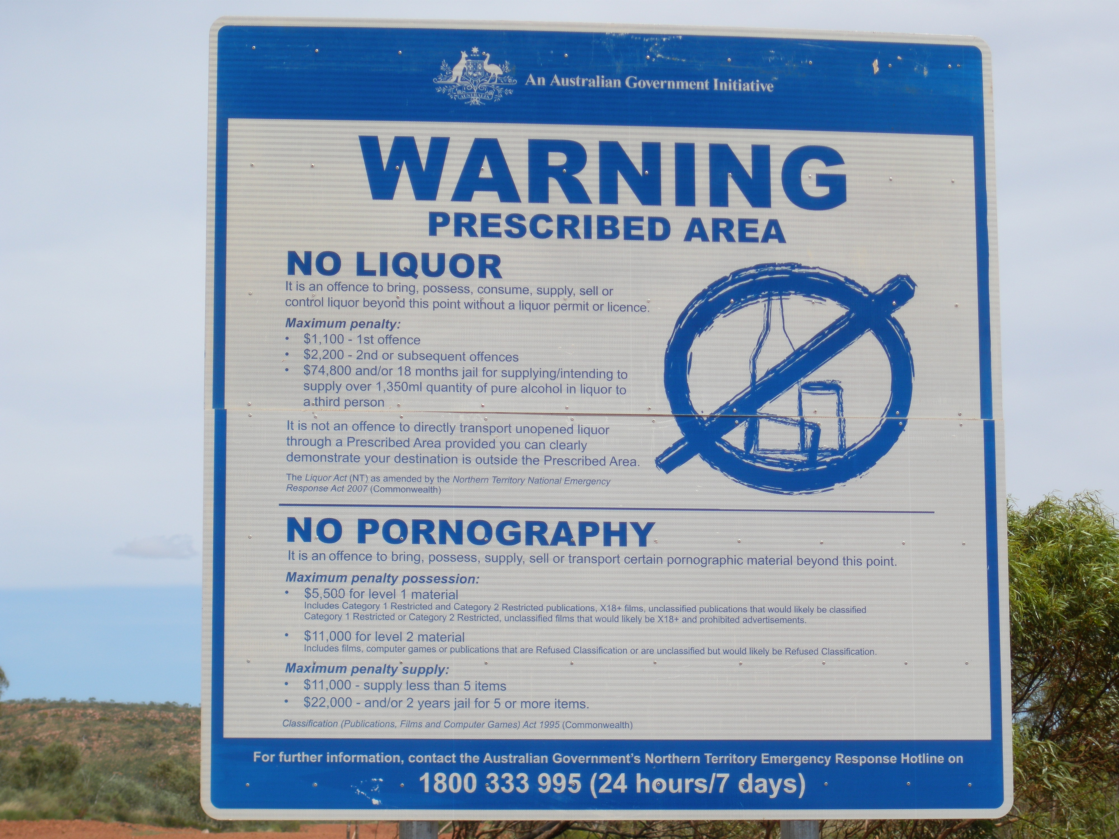
Some background
Northern Territory Emergency Response (NTER)
Launched in June 2007
Response to Inquiry into the Protection of Aboriginal Children from Sexual Abuse – concluded that sexual abuse in Aboriginal communities was at crisis level
Suite of initiatives:
alcohol and pornography bans
quarantine of welfare payments
removal of permit system
health checks for children
Notes:
Notes:
Presume most are familiar with the NT Emergency Response or the NT Intervention.
An Australian Government initiative.
‘Little Children are Sacred’ report.
Health checks for children: CHCI and EHSDI [intro to next slide…]
1 minute!

Slide 4
The CHCI & EHSDI
Sexual abuse of children
Urgent
EHSDI
Compulsory sexual abuse checks
Political process
Political/partner engagement
Little Children are Sacred
Media
CHCI
The Aboriginal People(s) of Northern Territory
Northern Territory Remote Health System
Follow-up services
Notes:
Notes:
Little bit of context on how we first saw the initiatives.
Target of the initiatives was the NT remote PHC system … of which Aboriginal people are a key part of the system.
Initially a lot of media interest in child sexual abuse – following Lateline episode…
Government [NT Government if someone asks] launched an inquiry – culminating in Little Children are Sacred report – which looked widely at the issue of Aboriginal child abuse – so issues to do with the breakdown of society including the cumulative effects of poor health, alcohol, drug abuse, gambling,
unemployment, poor education and housing, disempowerment, etc, that lead to violence and sexual abuse.
This then sparked a political process – centred around the Australian Government/Canberra – focusing on sexual abuse of children.
Seen by the Government as a ‘national emergency’, so given great urgency.
In terms of the NTER health initiatives, originally announced as compulsory sexual abuse checks … but quickly changed to be voluntary and to a wider health/wellbeing assessment … the CHCI.
Soon after follow-up services were included.
And then later, after further political engagement (including in the NT), and in consultation and collaboration with some key partners, another initiative, EHSDI was launched.
2 minutes!

Slide 5
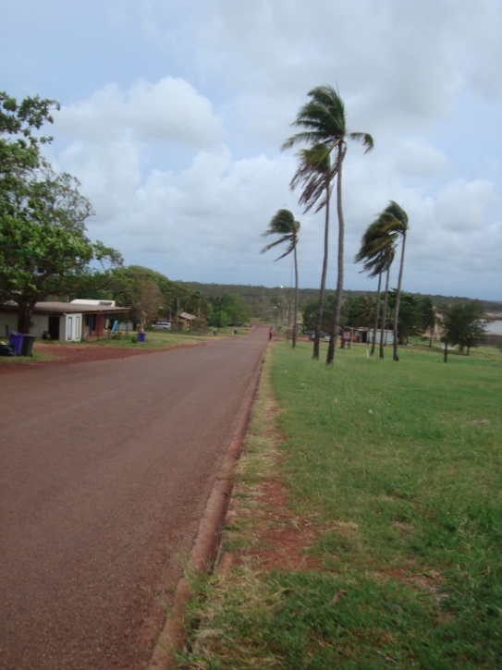
Child Health Check Initiative (CHCI)
Health checks for all Aboriginal children under 16 years living in the NTER prescribed areas
Delivered by (mainly) visiting teams of a doctor and nurses
Assessment of health and physical, psychological and social wellbeing
Expanded to include follow-up care: PHC, paediatrics, dental, hearing etc.
Checks from July 2007 – June 2009
Follow-ups from March 2008 – June 2012
Notes:
Notes:
Around 16,000 children in the eligible areas.
Sometimes visiting teams did the checks by themselves, sometimes they worked closely with local health clinic staff.
Around 10,000 children got a health check.
Spent around $18 million.
[It’s dental that run to 2012.]
Around 10,000 referrals for follow-up services, of which around 7,000 were followed up (ongoing).
Around $37 million spent (ongoing).
1 minute!

Slide 6
Expanding Health Service Delivery Initiative (EHSDI)
EHSDI was ‘the next phase’ of the CHCI
Focused on expansion and reform
Health system unable to cope with referrals from the CHCI
Builds on existing reforms of the remote PHC system
From July 2008 – July 2012
Notes:
Notes:
… expansion and reform … of the NT remote PHC system ... at the same time
Unable to cope – hence the focus on expansion.
The reform process did not start with EHSDI; it provided an opportunity to extend on existing reforms. These include CCTs, PHCAP, NT AHF, NT AH KPIs.
Around $90 million spent on EHSDI (ongoing). Total of around $180 million allocated (to June 2012).
1 minute!

Slide 7
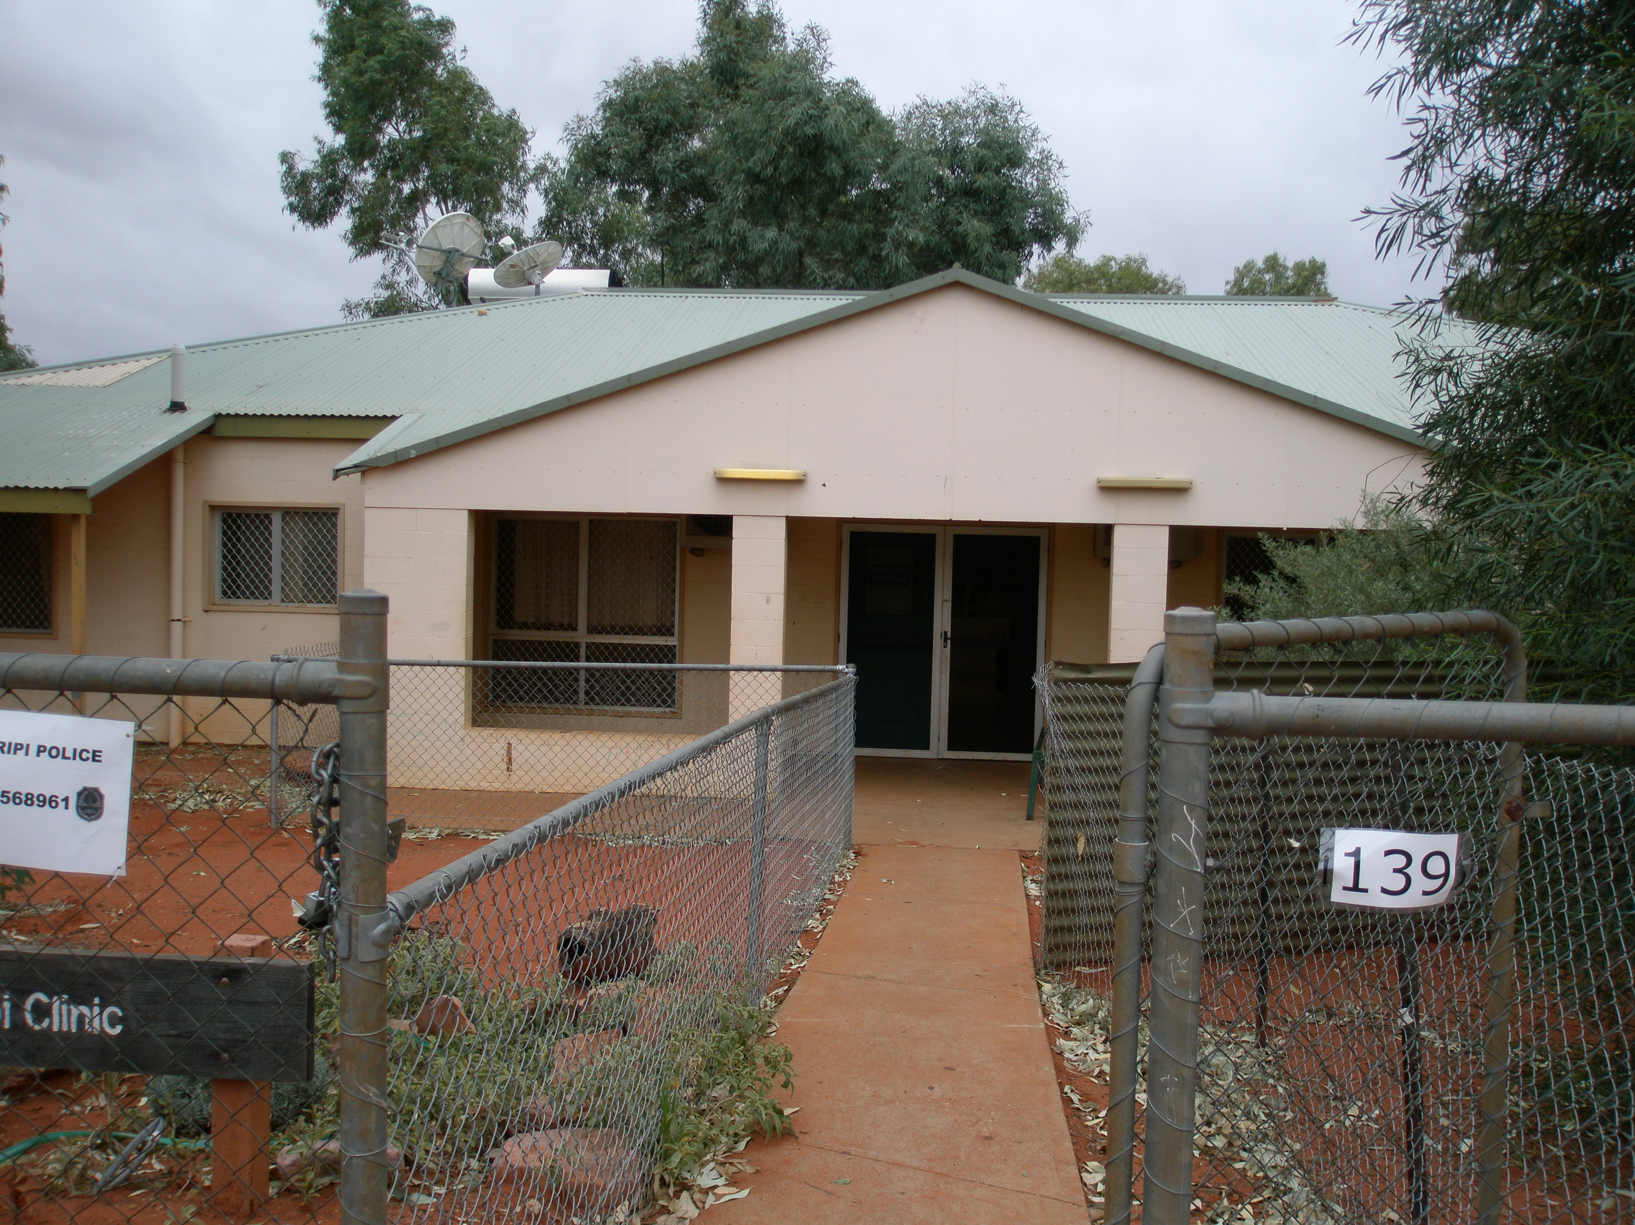
EHSDI objectives and goals
Expand PHC to improve access to core health services
Improve the quality of remote PHC services
Develop regional approaches to planning and delivery PHC services
Increase Aboriginal community control in planning and delivery
Notes:
Notes:
[purpose of this slide is to help give an idea of what EHSDI is … and to highlight its complexity]
EHSDI is an emergent program, so while there’s been some variation in the specific goals and objectives there is consistency around 4 areas:
Improve access
Improve quality
Develop regional approaches
Increase ACC
Together, these last two aim to bring regional ACC health services, which means:
Many services shifting from government-control to community-control
And many community services (either government of community-controlled) merging or forming new regional level services.
So … ambitious and complex program of both expansion and reform – in real terms saw an increase in PHC funding of almost 30% by the second year of the initiative.
90 seconds!

Slide 8
Evaluation objectives
Effectiveness | Efficiency | Appropriateness | (Sustainability)
CHCI Did the checks reach the target population? What conditions were found? Were the requested follow-up service received? (gaps, barriers) Were there improvements in health service delivery and health status?
EHSDI Impact on PHC service delivery, equitable distribution of resources Extent Aboriginal people engaged in health service planning and governance Efficiency in maximizing health service delivery Effectiveness in achieving change in health status Impact of regional reform process on operation of health services Impact and sustainability of RAHC on workforce availability and flexibility
Notes:
Notes:
3+1 overarching.
10 more detailed objectives.
Comprehensive set of objectives.
For CHCI more straightforward.
For EHSDI cover the breadth of the health system, including services, governance, funding and workforce.
1 minute!

Slide 9
Evaluation partners and participants
DoHA | NT DHF |  | AMSANT
Interagency groups and committees
Indigenous Advisory Group |  | Australian Institute of Health and Welfare
Participants Residents of NT remote Aboriginal communities Clinical staff in community health centres Regional health service staff Professionals and experts
Notes:
Notes:
Briefly, and really just to further demonstrate that this was a complicated and complex evaluation, there were multiple stakeholders (and each with slightly different interests in the evaluation).
Level 1: evaluation partners and interagency groupings.
Level 2: IAG (who provided us with independent advice), and AIHW (who monitored and reported on progress of the CHC and follow-up services).
Participants, including:
Parents/guardians and community leaders
Remote area nurses and Aboriginal health workers
[spell out ACCHO]
NT and national health professionals and experts.
1 minute!

Slide 10
Evaluation approach – overview
Initial view – complex system
Numerous stakeholders, complicated relationships, differing motivations and interest in the evaluation
Context for the initiatives
Trajectory
Two initiatives, two approaches
CHCI summative (add to existing evidence)
EHSDI formative (emergent/developmental)
Multiple methods
CHCI quantitative analysis, case studies, key informant interviews, literature/documents, workshops, consultation
Notes:
Notes:
Marnie has touched on our initial view already:
There were comprehensive evaluation objectives, 3 partner agencies each with own priorities, and 2 complex programs … one which was coming to a close and one which was just starting.
We saw context as critical to the evaluation and our approach, both in terms of the history of development in the PHC sector, and the more immediate context of the NTER.
We also saw trajectory as important, what was and had been going on in terms of Aboriginal health service access and outcomes.
For CHCI, there had been a lot of monitoring of implementation (who was checked, what referrals and treatment were provided, and what follow-up services were received), and the initiative was largely complete. The evaluation took a summative approach drawing both on the existing monitoring information and other information sources (largely the qualitative ‘story’ of what happened in communities), and some additional quantitative analysis of health datasets.
Given EHSDI was emergent and in its early days, we took a formative approach, working closely with the main program partners in, at times, a developmental way.
In terms of methods, I’m going to talk about a couple of approaches in more detail but just want to emphasise that it really was a mixed-method approach and we see that as one of its key strengths.
2 minutes!

Slide 11
Looked at all levels of health system
Federal level
Government agencies
Central level
Senior health administrators and policy officers
Peak bodies
Regional level
Health service clinical and administrative staff
Members of regional steering committees
Community level
Health clinic staff
Parents and guardians
Other community members and leaders
Interagency committees/working groups
National experts
National bodies
Notes:
Notes:
The other point I wanted to emphasise is the depth of the approach – we really did look at and engage with people with perspectives on all parts of the NT remote health system, including government and non-government perspectives, and people within 5 case study remote Aboriginal communities from 4 case study regions.
30 seconds!

Slide 12
Influence – looking beyond the initiatives
Considered context and health system trajectory, including history of development prior to the initiatives
Examined existing health checks and services for children
Looked at both the population that did, and did not, get checked (the non-participants)
Notes:
Notes:
We did not stick to evaluating the 2 initiatives in isolation.
We looked beyond the initiatives.
We’ve already talked about how we examined their context and the trajectory of health service access and impacts. We did get some pushback on this (esp our focus on examining the context of the NTER, (‘we know all that, what’s the use of reporting again on what happened?’), saying it went beyond the scope of the evaluation. However, we defended it. And feel we gave a very clear and dispassionate analysis of the context, including the political context, for the initiatives. We felt the context of the NTER had a profound effect on each of the initiatives, and excluding an analysis of this context would have limited the use of the findings. The context of the initiative was very useful in helping to explain and interpret many of the ‘stories’ we heard at a community level on the initiatives’ impacts.
For the CHC we also looked at the population of children who were eligible for a health check but did not have one. The monitoring data told us quite a lot about the 10,000 children who got checked, and we felt it was valuable to see how these children compared with the 6000 children who didn’t get checked. So the focus was very much on finding out if and how the two population groups were different; but short of undertaking any research as to why they might be different.
Ultimately this form of analysis would help to address questions about whether the group of children who had a CHC were more or less likely to need one than the group of children that did not have one; and whether any benefit brought about by the CHCs would likely be replicable in the group of children who did not get a CHC.
In order to do this …
First of all we identified the two population groups of interest: those who had a check and those who were eligible but did not.
Then we linked this data into existing NT datasets, such as the hospitalisation dataset, the maternity dataset and a dataset associated with an existing wellness check program.
The process was complex and there were some limitations associated with the data linkage process (eg, in identifying what children were within scope of the CHCI).
What we found was that:
The group of children who had a CHC were more likely to have been previously hospitalised than the population who did not have one
The group of children who had a CHC were more likely to already attend existing health check programs for children.
And that the population who had a CHC were no better (or worse) off that the children who didn’t get a check.
3 minutes!

Slide 13
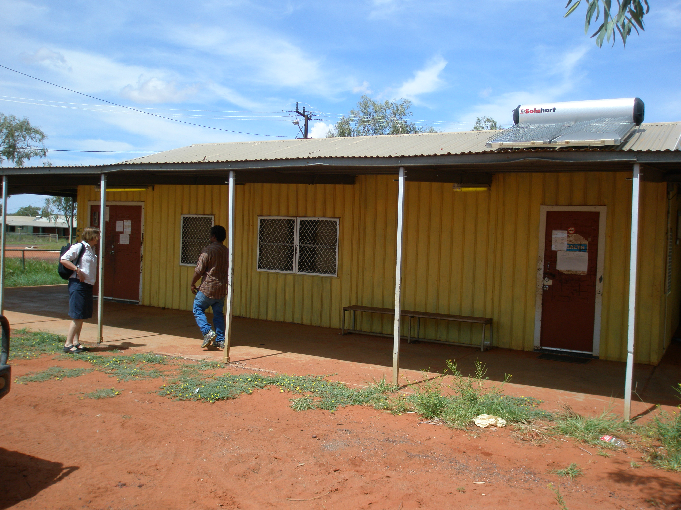
Influence – interacting with decision makers
Workshops for programme partners/decision makers
Formative/developmental focus
Real time reporting
‘Hot topics’ to which could bring external reference points and expertise
Facilitated a process
Not about providing solutions –
learnings were internalised
Back stories
Consensus building
Notes:
Notes:
Second area of influence want to touch on is the greater potential for influencing the implementation of programs – in this case the EHSDI – through formative evaluation where there’s real engagement and interaction with relevant decision makers.
Targeted those responsible for implementing the initiative from 3 partner agencies and cross-agency committees.
Held a couple of workshops aimed at capturing information and feeding it back to those responsible for implementing the initiative in real time so that it has the potential to contribute to program improvements.
In collaboration with partners, selected ‘hot topics’ for discussion at each workshop. Rather than focus on specific elements of EHSDI, looked at issues which cut across the initiative but that were playing a critical role in its performance (such as partnership working, communication, capacity and sustainability).
We were able to provide an external reference point to these issues, based on a brief review of relevant literature on the topic and our own experiences in these areas, as outsiders. This external perspective was very valuable to the staff charged with implementing the reforms who, due to their high workloads, tended to look for ideas and solutions from within the system as they did not get the opportunity to look beyond it.
As evaluators, we facilitated a process and created the ‘space’ for reflection and constructive discussion on the issues. We introduced the topics and raised critical questions to prompt thinking and discussion. We stopped short of proposing solutions but provided the catalyst for the partners to develop their own ideas answers to some of the challenges. In this way, the workshop learnings were internalised by the participants.
Through this process participants also got to understand each others ‘back stories’ – that is, the responsibilities of each partner outside of the three-way partnership – so DoHA’s to other AG departments; AMSANT’s to its member constituents, etc.
Finally the process helped to build consensus – we presented the main ideas and issues discussed back to the workshop participants for their agreement.
3 minutes!

Slide 14
Overall lessons
Context matters
Interactive evaluation processes with program decision makers
Evaluation priorities can change over time –challenge in answering set evaluation objectives and providing findings that are relevant
Notes:
Notes:
3 overall lessons from the evaluation process.
Context always matters in evaluation. In this evaln it was particularly critical. Includes the historical and political context for the initiatives, past processes and outcomes associated with them, and also other things going on at the time of the initiatives: such as the outcomes for non-participants of the CHCs and the impact of EHSDI on the wider system (not just the program areas).
Longer term, interactive evaluation processes enable learnings to be internalised by participants. Need to ensure engage with the right people so that the learnings then have influence. As the external evaluators, this interaction also ensures we are on the right track. One measure of success was when a key stakeholder chipped in with a ‘were you here yesterday’ comment when we were discussing progress on a key implementation barrier in relation to the initiative. He’d just come out of a all day workshop with senior health executives discussing the implementation of EHSDI and it was apparent that our thinking and findings were at the core to what was being discussed at the highest levels.
Lastly … and while not so fully discussed today … we feel there is an important lesson relating to identifying and agreeing evaluation priorities for emergent programs and formative evaluations which run over many months or years – there’s a need not to lose site of the initial evaluation objectives or questions, but also to ensure an evaluation meets current expectations and needs, and to ensure findings are relevant to current and future contexts.
1 minute!

Slide 15
Acknowledgements
The rest of the evaluation team: Don Matheson, Liz McDonald, Cat Barnes, David Clarke, John Marwick, Barry Borman, Jackie Cumming, Nea Harrison
The evaluation partners
DoHA
AMSANT
NT DHF
Members of the Indigenous Advisory Group
Australian Institute of Health and Welfare
The 85 participants in the 5 case study communities
The 90+ other evaluation participants
Notes:
Notes:
You guys for listening!
Then emphasise:
The 3 partner agencies
Members of the IAG
Participants in the 5 remote Aboriginal communities.

Slide 16
Further information: nhardie-boys@allenandclarke.co.nz mcarter@allenandclarke.co.nz Reports: www.health.gov.au/internet/main/publishing.nsf/Content/oatsih_chci-ehsdi_report www.allenandclarke.co.nz
Notes:
Notes:
Contact details.
Reports and further info.

